Slide 1
Invoice to Cash Process High-level overview – combined w/ Technical background

Slide 2
RACES I2C High-Level Process
ERP Process
Customer Connect
Order Management
Order Ship Confirmed
Interface to IBS
Internal
Project Accounting
AR Invoice Interface
AR Invoice Created
Cash Appl. Processing
AR Closing
AR Customer Master
Interface to GECARS
AR Invoices
Draft Invoice Approved
External
Accounting
Dr.
Cr.
Dr.
Cr.
Cash
Cash in Transit
Receivable
Receivable
Revenue
Prog. Bill
Adjustment Accounting
Credit Memo Applications
Bank Charges, write-offs etc.
Custom
CustomerConnect Interface
AR to GECARS Cust. Interface
GECARS to AR Cust. Interface
Customer Update Restriction
AR Invoice Upload WebADI (internal indirect)
Manual AR Invoice (external indirect)
Auto-Invoice Import
Suppress Zero Value Invoices
AR Interface Update
Reject Trx Missing VAT
Parts Rev Rec
Deferred Rev COGS Trx Details Report
Revenue Contingency: Manual Invoices (Mod 2)
Create Accounting
Invoice Print
Letter of Credit
Invoice Distribution & Storage (Mailbox & Documentum)
AR VAT Curr Conv. Program
AR WHT Adj. Report
AR to IBS Interface
Internal Within ERP Settlement*
GECARS Customer & OI Interface (via FDL)
Trx Not Processed to Settlement Systems report
Factoring WebADI
WCS Monetization Engine (via FDL)
Spotfire interface (via FDL)
IBS to AR Back Feed
GECARS Back Feed
AR Outstanding Report
GECARS Reconciliation Report
IBS Backfeed report
Prog Billing / Prog Coll
Bad Debt Provisioning
Closing Exception reports
AR Receipt Listing
AR Invoice Listing
AR Sales Report

Slide 3
I2C BOX Folders
Technical documentums/CDDs:
https://ge.ent.box.com/folder/8203290085
Training materials/SOPs:
https://ge.box.com/s/bpmcp7lror8nnbej8hxr81g6l448qfw5

Slide 4
Abbreviation and Terminology
Term | Full-Form | Definition
GECARS | GE Core Accounts Receivables System | A GE System to perform external collections on customer Transactions.
AR | Account Receivables | Oracle Applications Account Receivable Module.
LE | Legal Entity | A particular & discrete party created under the laws of a geopolitical territory & legally capable of entering into contracts, suing & being sued. Typically consists of 1 or more Statutory Entity Offices, Departments, & Transaction Entities. GE Policy requires geographic & employee benefit platform purity for most Statutory Entities (but there are exceptions for GEII & GEIOC)
CC | Company Code | Company Code
DFF | Descriptive Fled Fields | Configurable Fields in Oracle to hold additional information in Attributes. These DFF’s are assigned to different forms like Transactions, Customer Address etc.
EAI | Enterprise Application Integration | Enterprise application integration is an integration framework composed of a collection of technologies and services which form a middleware to enable integration of systems and applications across the enterprise.
GRC | Governance, Risk and Compliance | Oracle EBS Controls Governor Tool. Focuses on Access, Configuration, Preventative and Transactional controls for ERP. Supports ESGAP standardization and simplification model.
CTQ | Critical to Quality | Key process or product qualifications required to meet customr’s needs
IC | Investment Codes | Set up in GECARS at Management Entity level of the business. Investment code (IC) drives E-reports
BCO | Billing Component Code | Set up in GECARS at the legal entity level of the business. Billing Component Code (BCO) is usedby GECARS to identify to which business the transaction belongs to
BOP | Balance of Plant | Thermal term for emissions monitoring systems.
eFCM | Financial Contract Management | Thermal term for legacy billing system.
GPO | Global Projects Organization | Thermal’s Projects business
PSP | Performance Service Project | PGS service offering business.
SOA | Service oriented architecture | Architecture of middleware software used to transport data between systems.
OFM | Oracle Fusion Middleware | One of the many middleware solutions available in the market.
PB | Progress Billing | A series of invoices prepared at different stages in the process of a major project, in order to seek payment for the percentage of work completed
BAM | Business Application Monitoring | Reporting Tool in SOA to report the status of transaction

Slide 5
CustomerConnect – Limit Access

Slide 6
CustomerConnect – AR Customer Maintenance
MDM - customer addition process for external & internal
Subcribe customer existing internal & external customer Bill To/ Ship To sites to RACES
Update customer
Add new customer via D&B search
CC Stage env: https://stage.customerconnect.ge.com/
RACES – Customer Maintenance (Limit access)
Assigned Bill to/Ship to relation (if two different accounts need to be used in the same transaction)
Add/ update/ delete customer contact details (contact names, phone#, email address)
Assign Buyer/Seller relation (Billing interface setup is mandatory)
RACES AR Customer relationship – used for Revenue Accounting (Wdiv/WOB/OOB/External)
Billing interface (IBS – Internal/GECARS – External) – defines Receivables Account
Add reverse charge flag (Header/Site level) ... In case of special Tax treatment is required for certain customers
Manual submission of Interface
“GES MDM to AR Inbound Request Set”
“GES MDM to AR Interface”
“GE AR Customer Site Link Program”
Allowing Payments across different Legal Entities (Payor/Payee relationships)
Inactivating a Customer Site/Account.... Inactivation report published by MDM, but not automatically proceed, manual inactivation is needed in ERP
Technical Docs/CDDs:
GE ESGAP Baseline Design P&W Solution Print Symphony Limit Access to Customer Data
GE ESGAP Baseline DesignP&W Solution PrintSymphonyMDMto Oracle AR Customer Interface

Slide 7
AR Auto-accounting Technical documentum/CDD: GE Solution Print Common CEMLI Project Symphony GEPW_CDD_INT AR Global AutoAccounting

Slide 8
Account Segment Derivation
Chart Of Account | Receivable Class |  | Revenue Class | Tax Class
Company Code(4) | Order Line/Inventory Org
Natural Account(10) | Look-up defined to derive natural account on basis of 1> Billing Settlement method (GECARS/IBS) 2> Customer Relationship Type (External, WOB etc.) 3> Nature of Transaction (Domestic/Export) 4> Type of Transaction (Product/Services) (Please refer to next slide) |  |  | Tax Code
Trading Partner(4) | From Transaction or from source system |  |  | Tax Code
Cost Center(6) | Default from Transaction Type | To be picked from OM source for Indirect transactions. For other transactions default from Transaction Type | From source (OMis not there then default from Transaction Type | Tax Code
Geography(3) | Default from Transaction Type | Customer Ship-To Location. For US - the state For Canada - use Province else on basis of OU | Customer Ship-To Location. For US - the state For Canada - use Province else on basis of OU | Tax Code
Project(10) | Default from Transaction Type |  |  | Tax Code
Ref(6) | Default from Transaction Type
Product Line(6) | Default from Transaction Type
Book Type(1) | P
Future 1(9) | Default
Future 2(6) | Default

Slide 9
Driving Factors for Natural Account (Segment2)
Accounting Selection Criteria | Expected Values | Placeholder in ERP
Billing Settlement method | IBS/GECARS | Customer Bill to site - DFF
Customer Relationship Type | External Customer WOB – IBS OOB – IBS WOS- IBS WDIV - IBS | Customer Bill to site use information DFF
Nature of Transaction | Domestic/Export | If Ship to = OU country then Domestic else export
Type of Transaction | Product/Services | On basis of Inventory item - Organization Parameters DFF
Note: Corporate is planning to sunset WOD & OOB accounts to simplify As is HFM elimination process which is based on TP & Account to ONLY consider Account (impact on Wrong Account Usage Fatal Edit check) and centralize OOB & WOD data under WOB accounts while eliminate WOB tag on it
ACA accounts – effective from 1st Jan 2021
NonIBS accounts – negotiable effective date
IBS accounts –– negotiable effective date
Sales – effective from 1st Jan 2021
DR33/DR33A – negotiable effective date

Slide 10
Natural Account Mapping
Non Progress Billing | Receivable | Receivable Account - Description | Revenue | Revenue Account - Description
External Customer (Product/Services & Domestic/Export) | 1080201000 | Customers' Accounts-Current-External-Control | 4010101000 | Sales of Products to External Customers-Other
 |  |  | 4020101000 | Sales of Services to External Customers-Other
IBS OOB (Product - Domestic/Export) | 1510301012 | Undistributed Expenditures-IBS Outgoing | 4010601000 | InterCo-Product Sales-NonGECC-OOB
IBS OOB (Services - Domestic) |  |  | 4020601600 | InterCo-Service Sales-NonGECC-OOB-Domestic
IBS OOB (Services - Export) |  |  | 4020601650 | InterCo-Service Sales-NonGECC-OOB-Export
IBS WOB (Product - Domestic/Export) |  |  | 4010613000 | InterCo-Product Sales-NonGECC-WOB
IBS WOB (Services - Domestic & Export) |  |  | 4020613000 | InterCo-Service Sales-NonGECC-WOB
IBS WDIV (Services- Domestic & Export |  |  | 4020612000 | InterCo-Service Sales-NonGECC-Wdiv
IBS WDIV (Product - Domestic/Export) |  |  | 4010612000 | InterCo-Product Sales-NonGECC-WDiv
IBS WOS (Product - Domestic/Export) |  |  | 4010613000 | InterCo-Product Sales-NonGECC-WOB
 |  |  | 4020613000 | InterCo-Service Sales-NonGECC-WOB
IBS WOS (Services - Domestic & Export)

Slide 11
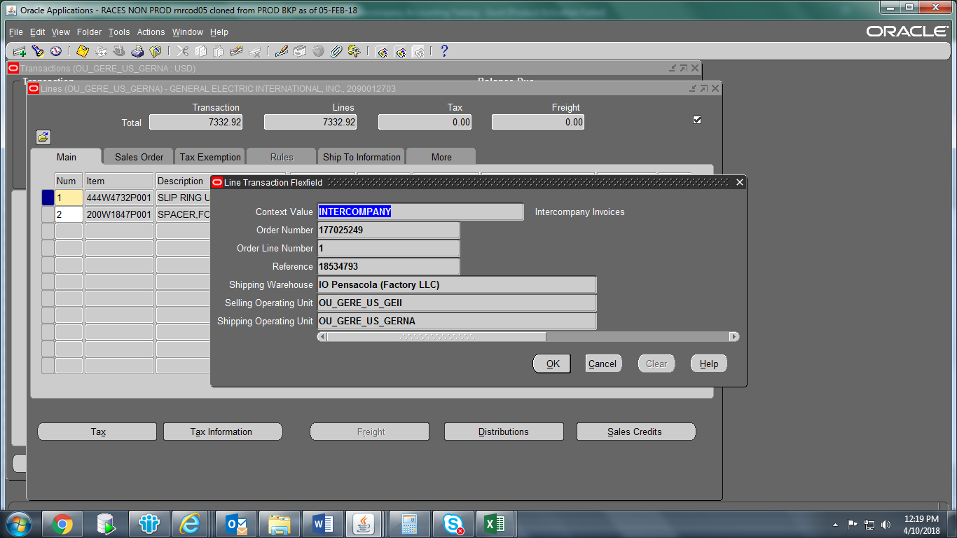
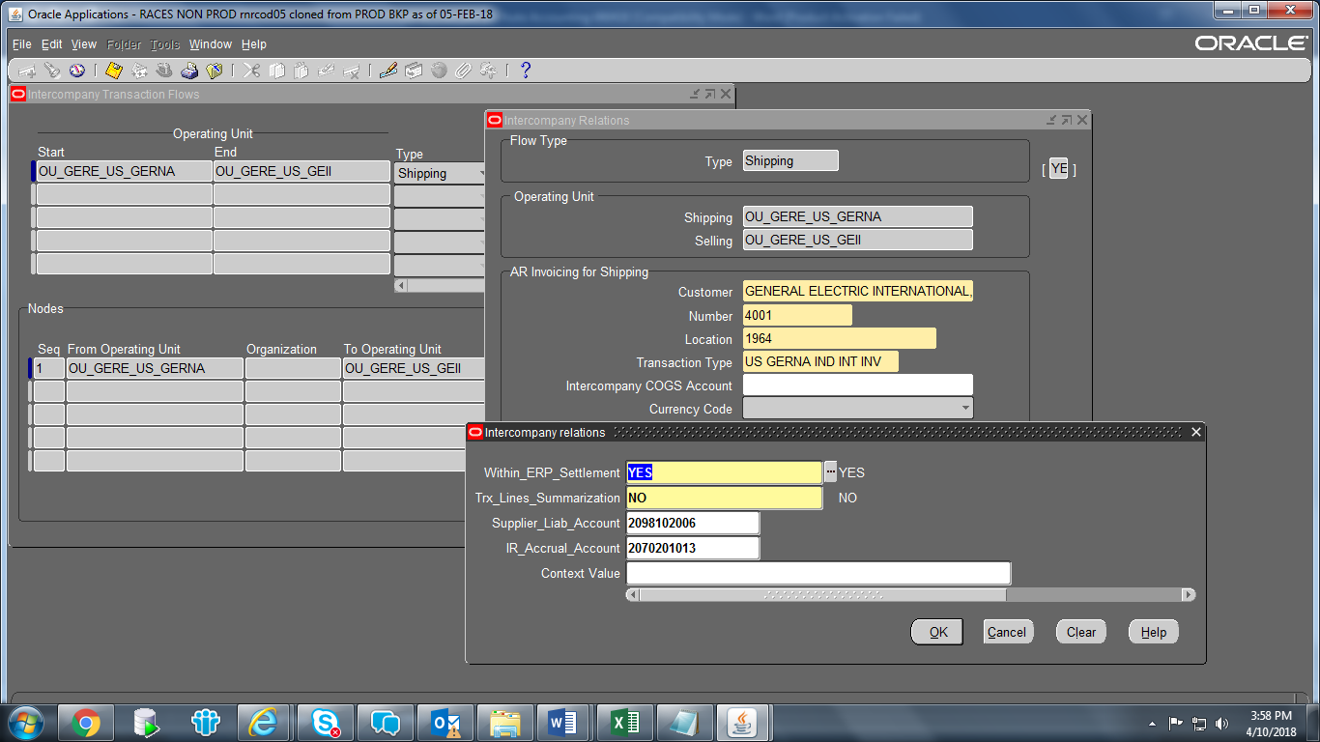
Logic to Identify Intercompany Transactions IBS or WERP
AR Transaction Flexfield or Line Transaction Flexfield would have two fields ‘Selling Operating Unit’ and ‘Shipping Operating Unit’. (#1 screenshot)
GERE Inv Setup (Global) -> Setup > Organization > Intercompany Transaction Flows -> Intercompany Relations
Start = Shipping OU & End = Selling OU
If Within_ERP_Settlement = ‘YES’ then the transaction would be considered as Within ERP transaction.
PO based → setup in Inventory module
ADN based → triggered by Trading Partner Code

Slide 12
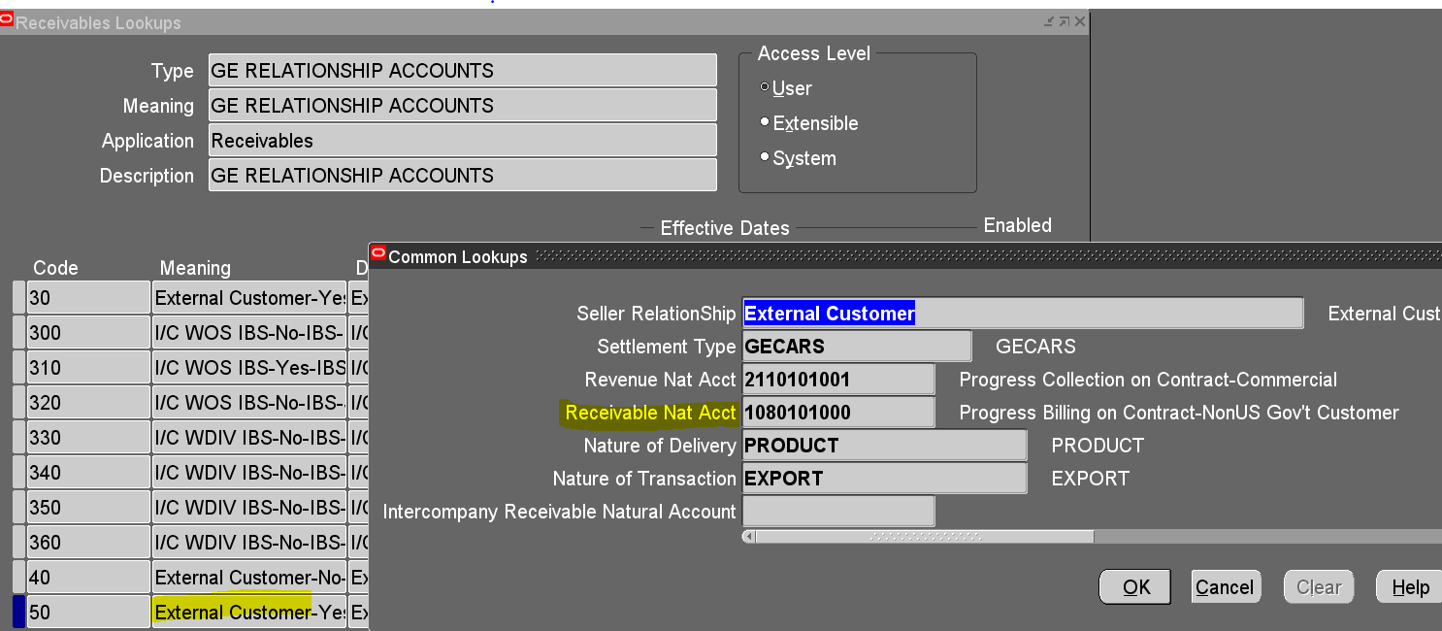
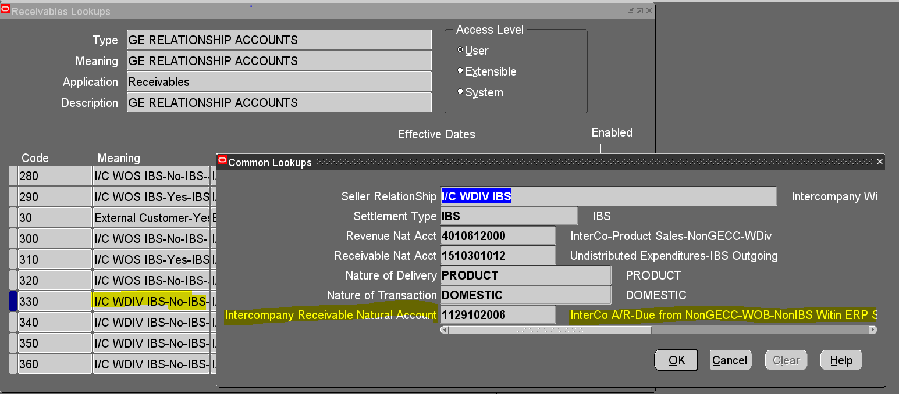
Solution for Intercompany Invoice
Intercompany transactions should have particular receivable natural account. This account has been captured in lookup ‘GE RELATIONSHIP ACCOUNTS’
For Within ERP in ‘Intercompany Receivable Natural Account’ field
For IBS & (EXTernal transactions too) in „Receivable Nat Acct” field

Slide 13
AR Transactions

Slide 14
AR Transactions
Sources
Order management – Order Ship confirmed → imported
Project Accounting – Draft Invoice → imported
IBS Backfeed
AR WebADI → imported (Manual Internal Billing) → AR Invoice Processing responsibility
Manual → manual EXT (mainly - Invoice Only Items (no Project or Order to assign to) → AR Invoice Processing responsibility
Advice: check BR100 for better understanding on below list of setups
Transaction sources:
GERE AR Setup (Global)>Setup>Transactions>Sources
GERE_REV_STR_PROJ_AR_TRAN_TYPE - REVENUE STREAM MAPPING TO AR TRANSACTION TYPE (PA items)
GERE AR Setup (Global)> Setup > System > Quickcodes > Receivables
Transaction types:
Setups: GERE AR Setup (Global)>Setup>Transactions>Transaction Types
Define Document Sequence – GL to setup
CS (xx1), TS (xx2), Parts (xx3) or NU (xx4), Manual EXT (xx5), Manual (webADI) INT (xx9)...
GE_AR_ITEM_TAX_MAPPING - Tax Item to Tax Code Mapping
GERE AR Setup (Global)> Setup > System > Quickcodes > Receivables
GE_AR_INV_TZ_CONVERSION - Receivable Lookup for Time zone conversion for AR Interface Line Update
GERE AR Setup (Global)> Setup > System > Quickcodes > Receivables
Memo Lines – for INT webADI:
GERE AR Setup (Global)> Setup> Transactions>Memo Lines

Slide 15
Intercompany – IBS process

Slide 16
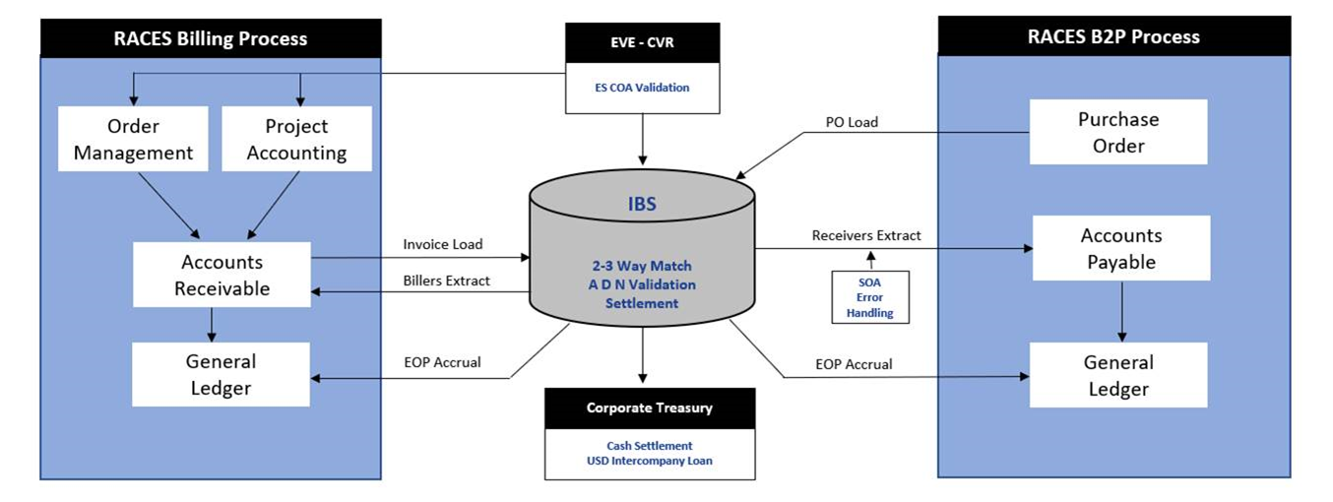
Overall IBS process
Note: between RACES ERP & IBS we are having in place a middleware, called SOA (ThreadConnect by 2021 Febr).... So no direct feeds between RACES & IBS

Slide 17
IBS Integration
GE_AR_IBS_PMTMOD setup: GERE AR Setup (Global)> Setup > System > Quickcodes > Receivables
- Payment Method for IBS to find out cash or current account
Reports:
Trx. Not Processed to Settlement Systems Report – list Trx which have not yet sent to IBS
AR IBS Backfeed report – lists created Receipts/DMs for a given period
SOA DIVE Dashboards - Stage env: https://stage-dive.apps.ge.com/ui
-Invoice Load (Forward Feed) & Billers Extract (Back Feed)
Technical Docs/CDDs:
CEMLI-163847 - GEPW_CDD_INT AR to IBS Forward Feed (*GE AR to IBS Interface program – scheduled in PROD... Can be run adhoc too)
- where Request set has been submitted, SOA will extract the data for that particular OU and send to IBS. After successful processing of data to IBS, GRC is updated by SOA
CEMLI-163840 - GEPW_CDD_INT IBS to AR Back Feed
- Additional note: on a daily basis SOA (middleware) extract settled transactions from IBS per RACES Biller BUC (Trx should be on status: „W” – Waiting for extraction status.... Extracted item status change from W to „E” – Extracted) and send back to ORACLE AR module ... Create Receipt to INV, Debit Memo to Credit Memo (1:1 relations)

Slide 18
Oracle/SAP ES IBS Outgoing Accounting
Goals
Common Process for SAP/Oracle
Complex process requires clear visibility to IT feed and process errors
Clearing Accounts with expected zero balances on LCD+1 a proven tool
IBS A/R
Invoice & Receipt
Accounts Receivable accounting
DR
CR
Accounts
CoCo
Account
TP
CoCo
Account
TP
1510301009 – Undist Exp Outgoing
1510301012 – Undist Exp IBS Outgoing Suspense
1510301012
IBS Outgoing
Sales/PB/
Deferred
Step 1 : Book Invoice
BHQ*
NA
Biz
TP
SAP Constraint
Step 2 : Receipt in AR
HQ
1510301009
Undist. Pay
NA
BHQ*
1510301012
IBS Outgoing
N/A
To attach trading partner to a customer the A/R account must also be TP enabled
Need TP “optional” for 1510301012
NA
Step 3 : Bank statement
reconciliation
HQ
Cash
NA
HQ
1510301009
Undist. Pay
N/A
Setups & Implications
All IBS Customers set up with A/R account of 1510301012
Non-IBS/IBS DF Account no longer used as Clearing
1510301012 should be zero at month end with EOP Accrual. If not zero, missed outgoing batch (IT interface) most likely
1510301009 should be zero at month end with final IBS backfeed. If not zero, check backfeed interface errors or missed backfeed batch
IBS End of Period Accounting
BHQ*
DF IBS
WOB/OOB
TP**
BHQ*
1510301012
IBS Outgoing
N/A
Book IBS EOP
Check 1510301012 during close and make process/missed feed accruals as appropriate
Check 1510301009 during close and make IBS Backfeed is fully booked (missed backfeed or stuck items)
* BHQ – Biz HQ is the single master CoCo attached to BUC profile, as per individual biz requirements from controllership & FP&A
** TP– Trading partner as defined in the IBS EOP report
*** If no PO, then book to cost account in A.D.N or cost account given to invoice

Slide 19
Oracle/SAP ES IBS Outgoing Accounting
Goals
Common Process for SAP/Oracle
Complex process requires clear visibility to IT feed and process errors
Clearing Accounts with expected zero balances on LCD+1 a proven tool
IBS A/R
CM & DM
Accounts Receivable accounting
DR
CR
Accounts
CoCo
Account
TP
CoCo
Account
TP
1510301009 – Undist Exp Outgoing
1510301012 – Undist Exp IBS Outgoing Suspense
Step 1 : Book Credit Memo
Biz
Sales/PB/
Deferred
TP
BHQ*
1510301012
IBS Outgoing
NA
SAP Constraint
1510301012
IBS Outgoing
NA
To attach trading partner to a customer the A/R account must also be TP enabled
Need TP “optional” for 1510301012
Step 2 : Debit Memo in AR
BHQ*
HQ
1510301009
Undist. Pay
NA
Step 3 : JE through Bank
statement reconciliation
Setups & Implications
HQ
1510301009
Undist. Pay
N/A
HQ
Cash
NA
All IBS Customers set up with A/R account of 1510301012
Non-IBS/IBS DF Account no longer used as Clearing
1510301012 should be zero at month end with EOP Accrual. If not zero, missed outgoing batch (IT interface) most likely
1510301009 should be zero at month end with final IBS backfeed. If not zero, check backfeed interface errors or missed backfeed batch
IBS End of Period Accounting
BHQ*
1510301012
IBS Outgoing
N/A
BHQ*
DF IBS
WOB/OOB
TP**
Book IBS EOP
Check 1510301012 during close and make process/missed feed accruals as appropriate
Check 1510301009 during close and make IBS Backfeed is fully booked (missed backfeed or stuck items)
* BHQ – Biz HQ is the single master CoCo attached to BUC profile, as per individual biz requirements from controllership & FP&A
** TP– Trading partner as defined in the IBS EOP report
*** If no PO, then book to cost account in A.D.N or cost account given to invoice

Slide 20
Intercompany – within ERP solution

Slide 21
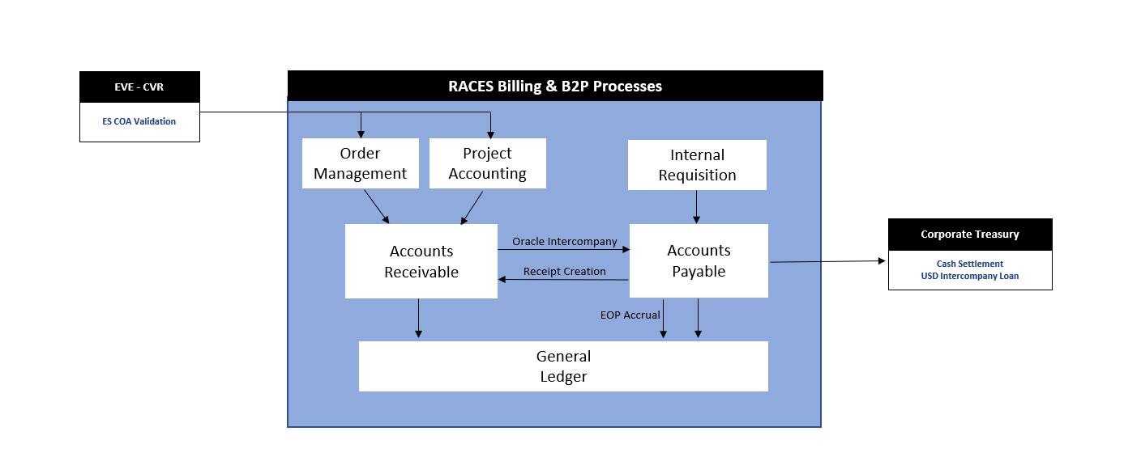
Within ERP ...bypassing IBS
Internal Invoices –
RACES to RACES trx – both OU should be eligible for within ERP solution (solution has not yet been deployed for restricted contries CH, VN etc..)

Slide 22
Process Flow for Transactions
Creation of ADNs based SO
IR ISO
Custom Program in AR (Update AR invoice flag to ignore the Non Participating AR Interco invoices)
Internal Requisition
Sales Order
AR Interface Table
AR Invoice/CM
(includes Sabrix tax call)
AR eligible Invoices
Create Intercompany AR : Both IR ISO and ADNs based
AR Interface Update & Autoinvoice
Create Intercompany AP
AR Receipt/Debit Memo
Payment Batch
(EFT/TRS/Clearing)
AP Invoice Validation
AP Invoice Creation on Intercompany hold
Payables Interface
1. Custom
Program in AP/AR
(AR Receipt processing)
2. Interface I/C Payments to Staging Table
3. AP Report of Payment batches
1. Custom
Program in AP
(Validate IR Receipt,
Release Interco hold,
Validate ADNs based invoices)
2. Send report of invoices on hold
Custom
Program in AP
(Verify Accounting date
Validate IR Receipt
Update Invoice Received Date
Trigger By-Pass of Sabrix Tax Call based
on Source
Update Paygroup/Paymethod for EFT
Submit Payables Open Interface Import
a. Clean batch where IR is received
b. Hold Invoice batch where IR is not received
c. ADNs based batch)
US to US : Clearing
Non US : EFT/TRS
AP Invoice Accrual for Interco Hold invoices
22

Slide 23
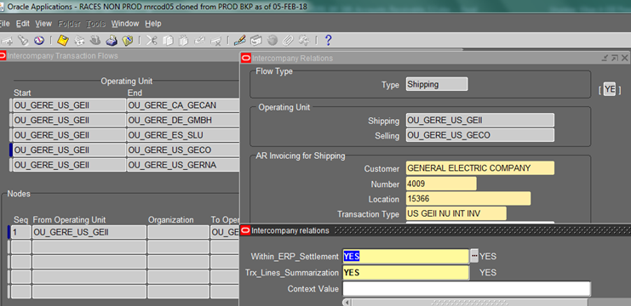
AR Custom programs
Technical Document/CDD:
„Global_CDD_Intercompany_Within_ERP_AR_Receipt_Creation”
GE AR Update Intercompany Transactions
- Fetch all the Intercompany transactions which are eligible based on DFF at Transaction header level (Shipping org id ,selling org id) to update the GRC on all Intercompany within ERP transactions to prevent sending them to IBS
Navigation: GERE Inv Setup (Global) -> Setup > Organization > Intercompany Transaction Flows -> Intercompany Relations
GE AR Intercompany Receipt Creation Program
- Create AR receipts for the Intercompany transactions paid through AP

Slide 24
Oracle/SAP ES Within ERP, Cross LE Outgoing
Goals
Follow similar accounting process as IBS intercompany transactions
Use non-IBS Within ERP undistributed expenditures invoice & cash clearing accounts
Provide clear visibility into IT custom programs and process errors
Within ERP A/R
Invoice & Receipt
Accounts Receivable accounting
DR
CR
Accounts
CoCo
Account
TP
CoCo
Account
TP
*1129102006 – InterCo A/R-Due from NonGECC-WOB-NonIBS Within ERP Settlement (DR13A)
1129102007 - InterCo A/R-Due from NonGECC-WOB-NonIBS Within ERP Cash Clearing
BHQ*
1129102006
Non-IBS WOE
TP
Biz
Sales/PB/
Deferred
TP
Step 1 : Book Invoice
HQ
1129102007
Due From Cash Clearing
NA
BHQ*
1129102006
Non-IBS WOE
TP
Step 2 : Receipt in AR
Step 3 : Bank statement
reconciliation
Cash / CP Borrowings
NA
1129102007
Due From Cash Clearing
NA
Setups & Implications
HQ
HQ
*TP required
1129102006 - not required to zero out at month end. No DR13A reporting required. Just internal reporting
Cross Legal MUST use cash or Cashpool Equiv of Borrowings … cannot use PCA/ACA
Step 3 (GL MJE) is required for Cross LE trx … control report(s) are needed to support
No EOP Accrual step required. Other controls reports are needed to monitor DT/DF disconnects
Check 1129102006 during close to confirm balance matches 2098102006 for total Within ERP
* BHQ – Biz HQ is the single master CoCo attached to BUC profile, as per individual biz requirements from controllership & FP&A
** TP– Trading partner
*** If no PO, then book to cost account on invoice

Slide 25
Monetization Engine Note: need to check whether this process will be applicable for LM or no need (as per Biz users LM is not factored as of now)

Slide 26
Monetization Engine –flowchart
REN
CORP
GENPACT
GE Capital
1 Factoring via GECARS
RACES
1
SOA
GECARS PRIME
Factorlink
Invoice feed sent to GECARS via SOA
Customer feed sent to GECARS via SOA
Transactional back-feed
Customer back-feed
Factoring file generated by GECARS
Feed to DWH and Spotfire
2
5
3
GEAR
4
FDL
DWH
6
Spotfire
TODAY
8
2 MONETIZATION ENGINE MODEL (live March)
RACES
SOA
GECARS PRIME
7. Factoring file generated by FDL
8. GECARS disputes & bankruptcy data sent to ME via SOA
FDL
Monetiz. Engine
Factorlink
7
GEAR
DWH
Spotfire

Slide 27
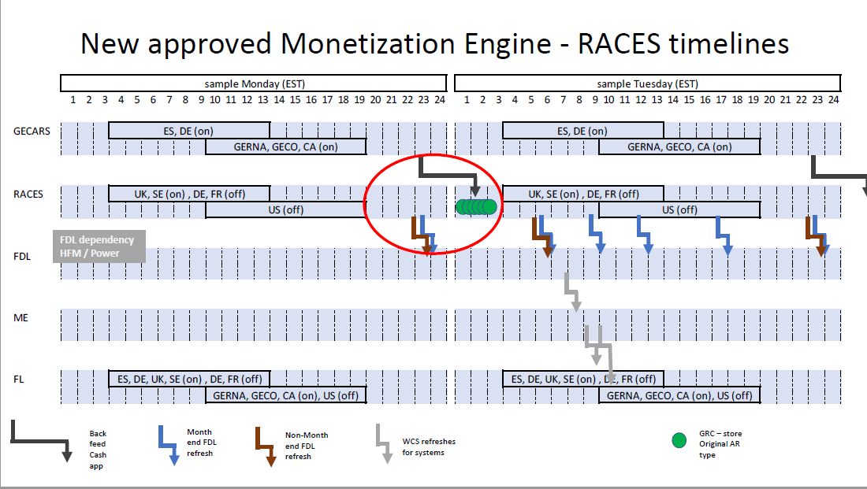
Note: Team is working on to eliminate dependencies from Prime

Slide 28

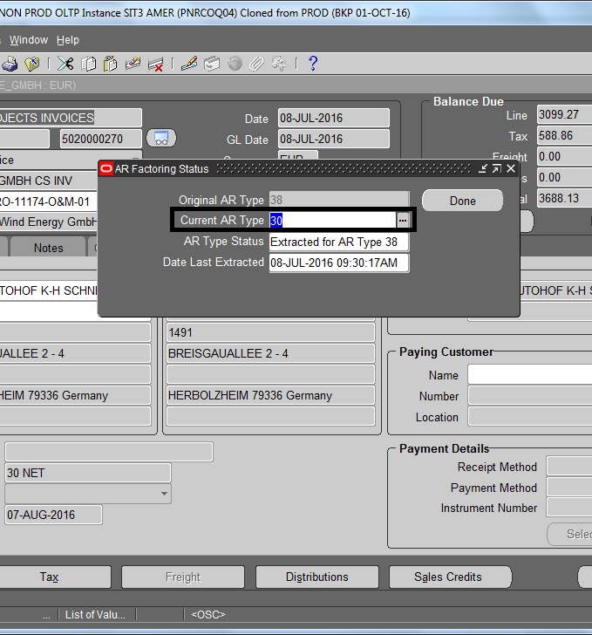
Factoring WebADI ...updating Trx types
Factoring Scope: External invoices
Extract WebADI to update multiple trx AR type:
1. Log in to Oracle using ‘GERE AR Invoice Processing (OU_’OU _NAME’) Responsibility.
2. Select link - Web ADI : Update AR Factoring Type from the menu
Select OU
Select CoCo
Select Trx types (both conversion & non-conversion related Trxs are eligible for updating)
AR type can be changed in “Current AR type column” in the WebADI
To check Factoring Status in Oracle:
Navigation : GERE AR Invoice Processing <OU> → Transactions → Transactions→ Search Invoice# →Click on Actions → ‘AR Factoring Status’ (also manual update is eligible here)
Technical Documentum/CDD: GERE AR Factoring Status Update Program
AR Factoring Status Program: a scheduled program to update AR Factoring Status GRC
Logic:
Custom AR program to insert AR Factoring Status GRC with following values when AR to GECARS forward feed is sent:
Original AR Type – Update it based on AR to GECARS forward feed query
Current AR Type – not to be updated
AR Type Status – Extracted for AR Type XX <Original AR Type>
Date Last Extracted – put the extraction date as in GECARS placeholder/system date
The program is dependent on the GECARS SOA Forward Feed(For GECARS OU ) and GERE AR GRC Update Program for Non GECARS OUs(for Non GECARS OUs) to update the AR Invoice Additional Attributes GRC which enables the AR Factoring Status GRC

Slide 29
Factoring webADI to update Trx type
possible combinations which can be allowed for the AR Type change:
• 108 ->101
• 101->108
• 38->30
• 30->38
38: non-progress billing factoring ineligible
30: non-progress billing factoring eligible -> for factoring
101: progress billing factoring eligible -> for factoring
108: progress billing factoring ineligible

Slide 30
Invoice Print

Slide 31
“GE AR Customer Invoice XML Report”
Technical doc/CDD: „WA – Global_CF250_Tax_RPT_Invoice Print_2016_11”
Responsibility: AR Super User OR AR Scheduled Jobs – can run/or schedule... Inserted as part of AutoInvoice Import program too
Only the completed Invoices and Credit Memo’s would be picked up for printing.
The Program needs to be able to select the appropriate template format for each Country.
For deriving the label name, program should correctly map the combination of template name (Derived from Tax set up under Legal Entity set up) & country and Label in the lookup (GE_INV_PRNT_LBL)
Dependencies:
‘GE AR VAT Reporting Curr Conv’ program & look-up ‘GE_INV_PRNT_LBL”
GERE AR Setup (Global)> Setup > System > Quickcodes > Receivables
„GE_INV_PRNT_LBL „ – master lookup ... contains the label code and the label text is derived based on the country
AR to Documentum integration – middleware is SOA (called by DARE program)
Stage Documentum: https://qa-edms.pw.ge.com/dctmfinance/component/main
Technical doc/CDD: „GEPW_CDD_AR_INT_AR Invoice to Documentum Store”
Concurrent Request Name: GE AR Invoices to Documentum Store
Responsibility: AR Super User (Program should be available to all AR Super User Responsibilities across Operating Units)
Frequency and timing of report run: Scheduled as part of the AR Auto-Invoice Request Set after the invoice print program
Stores INTernal & EXTernal prints
Multiple upload of same documentum is not allowed
Dependencies: transactions should have been successfully interfaced to AR module, Invoice Print program should have been successfully completed
Once successful load to Documentum, URL is sent by Documentum as Acknowledgement stored on AR Invoice header under Attachment

Slide 32
Cash application & adjustments

Slide 33
Setups
Advice: check BR100 for better understanding on below list of setups
Receivable Activities:
GERE AR Setup (Global)>Setup>Receipts>Receivable Activities
Define Bank:
GERE CE Bank Maintanance --> Setup --> Banks --> Banks
Receipt Classes:
GERE AR Setup (Global)>Setup>Receipts>Receipt Classes
Approval limit:
GERE AR Setup (Global)>Setup>Transactions> Approval Limits
Progress Billing to Progress Collection reclass - This logic is only applicable for receipts which are applied to progress billed type of transactions
(note: PBPC reclass could be handled in PA module as well bypassing AR solution... In that case reclass would happen in PA as part of month end closing. There is an automation process in PA to reclass PB to PC (by checking collection details) and PC to UBR (if more revenue booked)
AR Technical doc/CDD: GEPW_CDD_INT AR Progress Billing Reclassification to Progress Collection

Slide 34
Bad Debt provisioning

Slide 35
Scope
External(GECARS settlement system – External AR Accounts) items (Internal is excluded)
CM is not considered, if there is a CM issued to an invoice, but not get applied then the impacted INV due
RACES BDR solution are taking in consideration Services/Other invoices from 90+days
From Days | To Days | Percent
91 | 180 | 20
181 | 360 | 30
360 |  | 100
GERE AR Setup (Global)> Setup > System > Quickcodes > Receivables
Exclude Equipment CoCo
Technical doc/CDD: GEPW_CDD_EXT_AR Bad Debt Provisioning

Slide 36
Process for Services
Pre-Report
New Report Developed to show the list of invoices considered for BDR
Program Run
Runs for specific Company Codes not set for exclusion
Mgmt. Review
Ability to change certain account segments if needed
Post to GL
Validate in GL
Automatic posting to GL
Email acknowledgement of Accounting Program
Provides a report showing proposed GL Entries
Report to be used as back-up for BDR entries
Company Code appended with _VE to force into management review
Manual Process to validate final BDR booking in GL
Accrual – will be auto-reversed in the next period
**this step will be automated by 2021 → direct hit onto GL

Slide 37
Accounting - Services
Segment | Derivation/Value | Description
Company Code | Revenue Account Company Code for the invoice | PR2W for Australia, PR2X for Japan, PRCE for Thailand
Natural Account | Debit Entry: 5330104000 Credit Entry: 1090102000 | Provision for Receivable Losses (Variable) A/R-Reserve-Current-CYChg
Trading Partner | 0000
Cost Center | Debit Entry: PWV160 Credit Entry: 000000 | Services - Services Operations
Geography | Debit Entry: AUS for Australia, JPN for Japan, THA for Thailand Credit Entry: 000
Project | Debit Entry: PW00000001 Credit Entry: 0000000000 | Other
Ref | 000000
Product Line | Debit Entry: PW9000 Credit Entry: 000000 | Other
Ledger | Dr. | Cr.
Australia | PR2W-5330104000-0000-PWV160-DEU-PW00000001-000000-PW9000-P-000000000-000000 | PR2W-1090102000-0000-000000-000-PW00000001-000000-PW9000-P-000000000-000000
Japan | PR2X-5330104000-0000-PWV160-ESP-PW00000001-000000-PW9000-P-000000000-000000 | PR2X-1090102000-0000-PWV160-ESP-0000000000-000000-000000-P-000000000-000000
Thailand | PRCE-5330104000-0000-PWV160-ESP-PW00000001-000000-PW9000-P-000000000-000000 | PRCE-1090102000-0000-PWV160-ESP-0000000000-000000-000000-P-000000000-000000
*Posted to both Primary and Secondary ledgers

Slide 38
Parts Revenue Recognition for External PARTS Invoices

Slide 39
Scope - overview
Setups:
GERE AR Setup (Global)> Setup > System > Quickcodes > Receivables
GERE_OM_TYPES_FOR_DEF_REV_RPT - List of OM Order types which will be used in GERE Deferred Rev COGS Transaction Details Report
GERE AR Setup (Global)> Setup > System > Quickcodes > Print > Receivables > Receivables Lookups
GERE LAG TBL BY REGION MATRIX
Report & RevRec program:
AR Deferred Revenue COGS Transaction Details report - GERE AR Invoice Processing → can run adhoc or schedule
will show all External Parts Sales Order for which Revenue are not recognized yet and the Order status is in Pending Post Billing Status (scedhuled in PROD)
GERE AR Recognize Revenue for Parts program – GERE AR Accounting or Scheduled Jobs → scheduled program in Production
it is handling the revenue recognition (reclass from Unearned Rev to Revenue once the conditions of the program are met (Ship to location of the counterparty, LAG days logic, External Parts SO where Customer Acceptance Revenue Contingency has been applied)
Cost of Goods Sold accounting first recorded under Deferred COGS → in PROD COGS Recognition program is also scheduled and it would happen the same day when Revenue gets Recognizes
Lag days for revenue contingency are setup in lookups:
Within country = 3 days
Out of country but Within region = 5 days
Out of region = 18 days
To North Africa = 25 days
A scheduled program will record customer acceptance of SO line (for external parts sales only) based on the calculation [System Date Minus Ship Date Actual of SO line >= LAG days ]

Slide 40
AR Reports

Slide 41
AR Reports
AR Outstanding Receivables Status report - open items aging report
AR Sales Report - invoice summary level
AR Invoice Listing - invoice line item level
AR Receipt Listing - applied & unapplied/unidentified receipts

Slide 42
AR Closing activities

Slide 43
Closing Steps
1. Auto Invoice Interface Check - GERE % AR Invoice Processing (GERE_OU_XX_XX )
2. Import Transaction/lines available in the AR Interface - GERE % AR Invoice Processing (GERE_OU_XX_XX )
- Applicable only if you find unprocessed, stuck transactions in Step # 1 related to closing period. If there are no stuck records, you can proceed directly to Step # 3
3. Incomplete Invoice Report - GERE % AR Invoice Processing (GERE_OU_XX_XX )
4. AR Transactions Not Processed to IBS Settlement – AR Invoice - GERE % AR Invoice Processing (GERE_OU_XX_XX )
5. IBS Backfeed Status - SOA DIVE Dashboard
6. Unposted Items Report - GERE % AR Invoice Processing (GERE_OU_XX_XX )
7. Subledger Period Close Exception Report - GERE % AR Accounting (OU_GERE_XX_XX)
8. AR to GL Reconciliation Report - GERE % AR Accounting (OU_GERE_XX_XX)
9. AR Outstanding Receivables Status Report -GERE % AR Invoice Processing (GERE_OU_XX_XX )
10. Close AR Period - GERE % AR Accounting (OU_GERE_XX_XX)
11. Open next AR Period - GERE % AR Accounting (OU_GERE_XX_XX)
Schedule program for Deferred Revenue Account reconciliation activity – if period is closing before LCD+1 need manual run
‘GERE Deferred Rev COGS Transaction Details Report’ helps to report AR Invoices for which Revenue has not been recognized and to reconcile Deferred Revenue Account for Parts Sales

Slide 44
Auto-Invoice Import Program
Order Management and Project Accounting are the Oracle Sources which will interface eligible invoice lines to the Accounts Receivable module to create an AR transaction. Lines will sit in the AR interface table until the overall Auto Invoice Program runs
PRC: Interface Invoices to Receivables – Interfaces Project transactions from PA module
Create Intercompany AR Invoices - interfaces Internal Sales Orders from Order Management module
GERE Expense Intercompany PO creation with Freight - creates PO for Intercompany sales Orders
GERE AR Interface Update Program - updates the particular set of Invoice and Credit memo attributes in the AR interface table (summarizes the line records for Intercompany invoices, based on Shipt to inv.org)
GE AR Restrict Transactions Missing VAT Exchange Rate - rejects the transactions missing Official VAT exchange rate in AR Interface itself to prevent transactions import in AR
Autoinvoice Master Program - imports the Transactions into AR from the Receivables interface (Select PA)
PRC: Tieback Invoices from Receivables - tie back AR invoice number with PA Draft Number (PA Team will be able to identify AR Inv# from PA module itself)…update the status of PA transactions back to Project Accounting
Autoinvoice Master Program - imports the Transactions into AR from the Receivables interface (Select OM)
Create Accounting - generates the Accounting for the successfully imported transactions and transfer them to General Ledger
GE AR VAT Reporting Curr Conv Program - automatically updates AR Transaction attributes at the transaction header and distribution level, which are being used by the invoice print program
GE AR Invoice Print and Documentum Filter Program - creates the PDF files for all new AR transactions created during that particular auto invoice run and sends it over to Documentum for archiving

